Slide 1
Lecture # 1
CHAPTER # 1

Slide 2
Course Objective:
1.Express statements with the precision of formal logic
2.Analyze arguments to test their validity
3.Apply the basic properties and operations related to sets
4.Apply to sets the basic properties and operations related to relations and functions
5.Define terms recursively
6.Prove a formula using mathematical induction
7.Prove statements using direct and indirect methods
8.Compute probability of simple and conditional events
9.Identify and use the formulas of combinatorics in different problems
10.Illustrate the basic definitions of graph theory and properties of graphs
11.Relate each major topic in Discrete Mathematics to an application area in computing
Recommended Books:
1.Discrete Mathematics with Applications (second edition) by Susanna S. Epp
2.Discrete Mathematics and Its Applications (fourth edition) by Kenneth H. Rosen
3.Discrete Mathematics by Ross and Wright

Slide 3
MAIN TOPICS:
1. Logic
2. Sets & Operations on sets
3. Relations & Their Properties
4. Functions
5. Sequences & Series
6. Recurrence Relations
7. Mathematical Induction
8. Loop Invariants
9. Loop Invariants
10. Combinatorics
11. Probability
12. Graphs and Trees

Slide 4
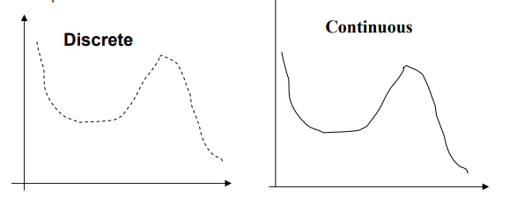



Slide 5
What is Discrete Mathematics?
Discrete Mathematics concerns processes that consist of a sequence of individual steps.
LOGIC: Logic is the study of the principles and methods that distinguish between a valid and an invalid argument.
DIFFERENT TYPES OF LOGIC :
PROPOSTIONAL LOGIC
PREDICATE (FOL) LOGIC
HIGHER ORDER LOGIC
TEMPORAL LOGIC
FUZZY LOGIC

Slide 6
STATEMENT/ PROPOSITIONS:
A proposition is a declarative sentence (that is, a sentence that declares a fact) that is either true or false, but not both.
It was first developed systematically by the Greek philosopher Aristotle more than 2300 years ago.
1) Logic is interesting. A statement
2) It is hot today. A statement
3) -1 > 0 A statement
4) x + y = 12 Not a statement

Slide 7
PROPOSITIONAL VARIABLES:
We use letters to denote propositional variables (or statement variables), that is, variables that represent propositions, just as letters are used to denote numerical variables. The conventional letters used for propositional variables are p, q, r, s, . .
EXAMPLES:
p = “Islamabad is the capital of Pakistan”
q = “17 is divisible by 3”

Slide 8
PREDICATE LOGIC:
If the sentence is preceded by other sentences that make the pronoun or variable reference clear, then the sentence is a statement.
Not Propositions
Example:
x = 1
x > 2
x is greater than 2.
He is very rich
Propositions
Example
Bill Gates is an American
He is very rich
“He is very rich”.

Slide 9
COMPOUND PROPOSITIONS:
Many mathematical statements are constructed by combining one or more propositions. New propositions, called compound propositions, are formed from existing propositions using logical operators.
EXAMPLES:
1. “3 + 2 = 5” and “Lahore is a city in Pakistan”
2. “The grass is green” or “ It is hot today”
3. “Discrete Mathematics is not difficult to me”
AND, OR, NOT are called LOGICAL CONNECTIVES.

Slide 10
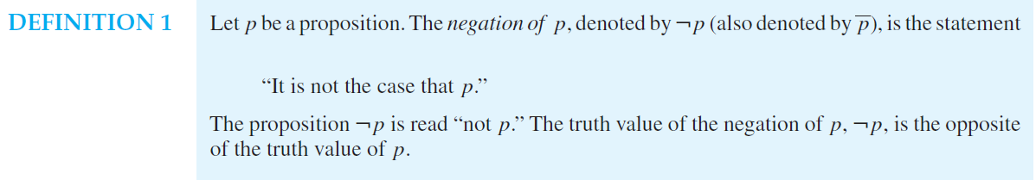
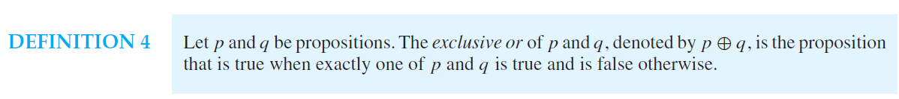
LOGICAL CONNECTIVE:

Slide 11
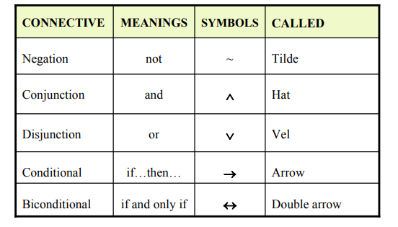

Slide 12
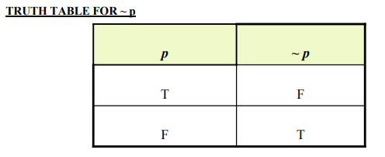
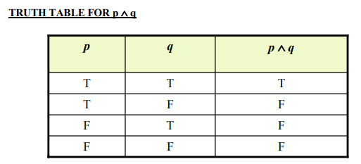
Truth Table A truth table specifies the truth value of a compound proposition for all possible truth values of its constituent propositions.

Slide 13
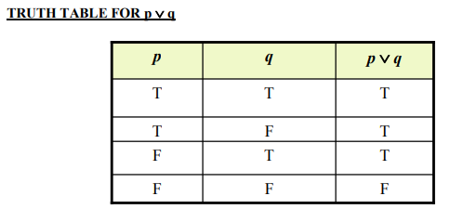

Slide 14
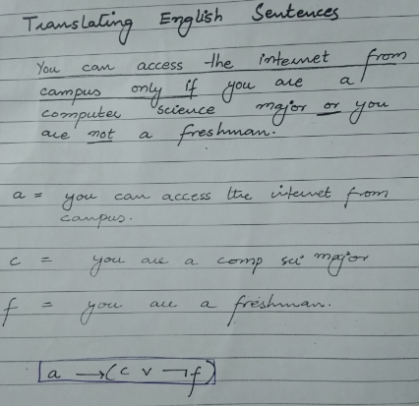

Slide 15
EXAMPLES # 1
COVERT THE FOLLOWING STATEMENTS IN THE SYMBOLIC REPRESENTATION
p = “Islamabad is the capital of Pakistan”
q = “17 is divisible by 3”
1) “Islamabad is the capital of Pakistan and 17 is divisible by 3”
2) “Islamabad is the capital of Pakistan or 17 is divisible by 3”
3) “Islamabad is not the capital of Pakistan”

Slide 16
EXAMPLES # 2
TRANSLATING FROM ENGLISH TO SYMBOLS
Let
p = “It is hot”,
q = “ It is sunny”
SENTENCE SYMBOLIC FORM
1.It is not hot. ~ p
2.It is hot and sunny. p ∧q
3.It is hot or sunny. p ∨ q
4.It is not hot but sunny. ~ p ∧q
5.It is neither hot nor sunny. ~ p ∧ ~ q

Slide 17
EXAMPLE # 03
Let
h = “Zia is healthy”
w = “Zia is wealthy”
s = “Zia is wise”
Translate the compound statements to symbolic form:
1) Zia is healthy and wealthy but not wise. (h ∧ w) ∧ (~ s)
2) Zia is not wealthy but he is healthy and wise. ~ w ∧ (h ∧ s)
3) Zia is neither healthy, wealthy nor wise. ~ h ∧ ~ w ∧ ~ s

Slide 18
EXAMPLE # 04
TRANSLATING FROM SYMBOLS TO ENGLISH:
Let
m = “Ali is good in Mathematics”
c = “Ali is a Computer Science student”
Translate the following statement forms into plain English:
1) ~ c Ali is not a Computer Science student
2) c∨ m Ali is a Computer Science student or good in Math's.
3) m ∧ ~ c Ali is good in Math's but not a Computer Science student

Slide 19
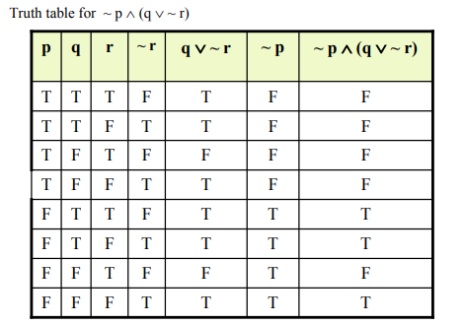
EXAMPLE # 05
Truth Tables :
1. ~ p ∧ q
2. ~ p ∧ (q ∨ ~ r)
3. (p ∨ q) ∧ ~ (p ∧ q)

Slide 20

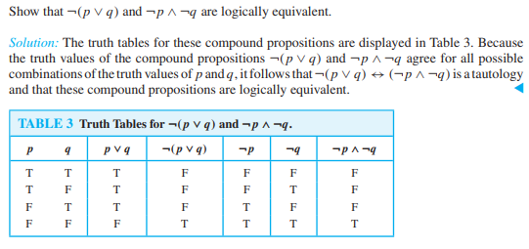

Slide 21
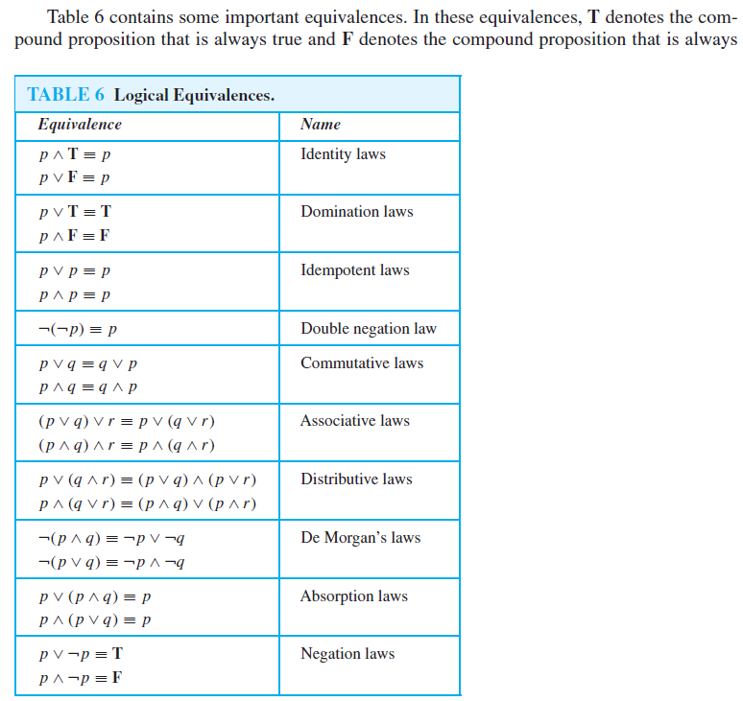
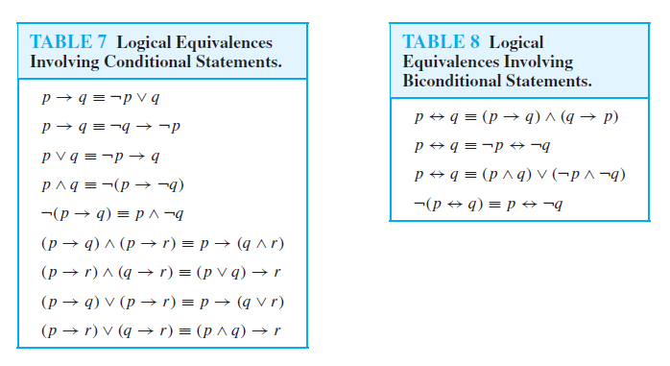

Slide 22
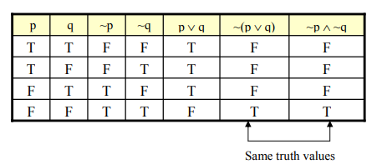
DE MORGAN’S LAWS
1) The negation of an AND statement is logically equivalent to the OR statement in
which each component is negated.
Symbolically ~ (p ∧ q) ≡ ~ p ∨ ~ q
2) The negation of an OR statement is logically equivalent to the AND statement in
which each component is negated.
Symbolically ~ (p ∨ q) ≡ ~ p ∧ ~ q
Truth Table of ~ (p ∨ q) ≡ ~ p ∧ ~ q

Slide 23
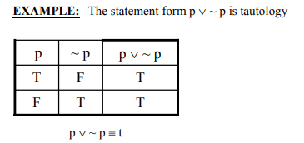
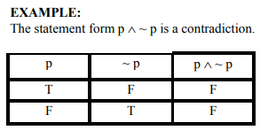
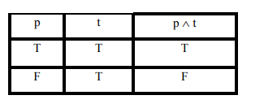
TAUTOLOGY: A tautology is a statement form that is always true regardless of the truth values of the statement variables. A tautology is represented by the symbol “t”.
CONTRADICTION: A contradiction is a statement form that is always false regardless of the truth values of the statement variables. A contradiction is represented by the symbol “c”.
A compound proposition that is neither a tautology nor a contradiction is called a contingency.

Slide 24
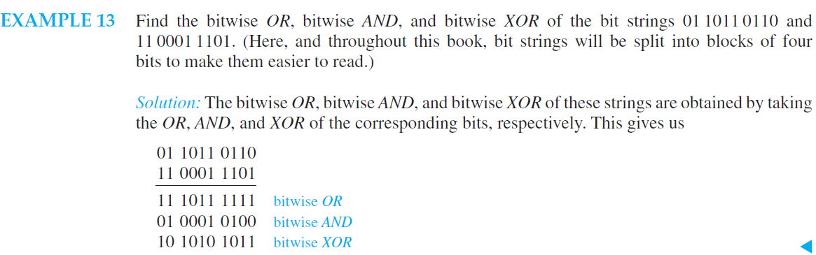
LOGIC AND BIT OPERATIONS:

Slide 25
LECTURE # 2
CHAPTER # 1

Slide 26
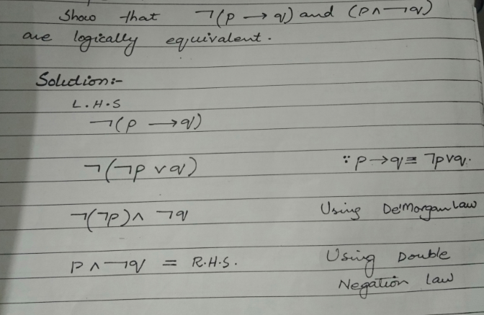

Slide 27
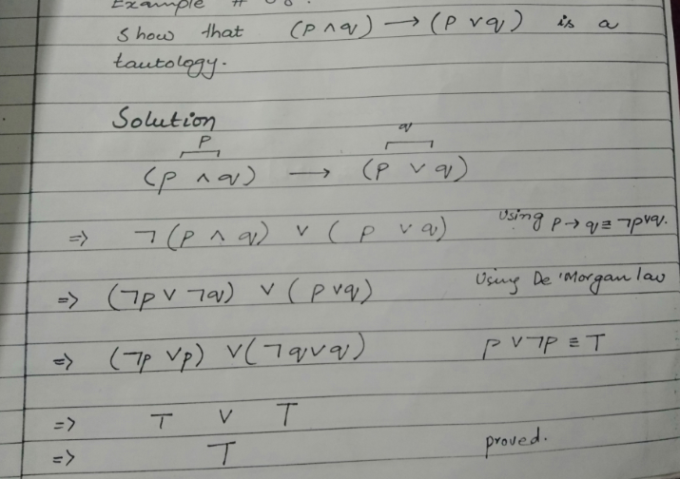

Slide 28
APPLYING LAWS OF LOGIC
Using law of logic, simplify the statement form
p ∨ [~(~p ∧ q)]
Solution:
p ∨ [~(~p ∧ q)] ≡ p ∨ [~(~p) ∨ (~q)] DeMorgan’s Law
≡ p ∨ [p∨(~q)] Double Negative Law: ~(~p) ≡ p
≡ [p ∨ p]∨(~q) Associative Law for ∨
≡ p ∨ (~q) Idempotent Law: p ∨ p ≡ p
That is the simplified statement form.

Slide 29

SIMPLIFYING A STATEMENT:
“You will get an A if you are hardworking and the sun shines, or you are hardworking and it rains.”
Rephrase the condition more simply.
Solution:
Let
p = “You are hardworking’
q = “The sun shines”
r = “It rains” .
The condition is (p ∧ q) ∨ (p ∧ r) Using distributive law,
(p ∧ q) ∨ (p ∧ r) ≡ p ∧ (q ∨ r)

Slide 30
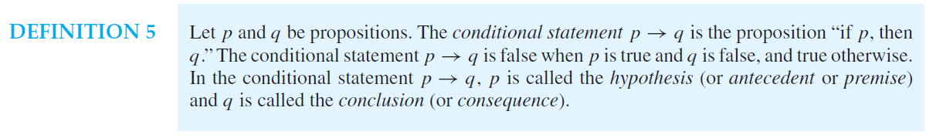
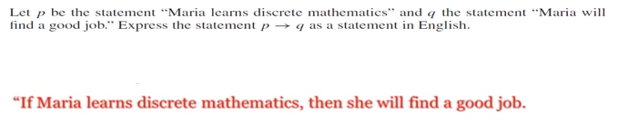
CONDITIONAL STATMENTS:
QUESTION:

Slide 31

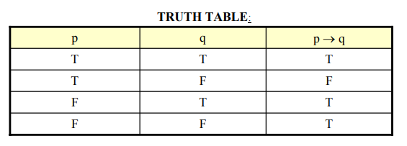

Slide 32
PRACTICE WITH CONDITIONAL STATEMENTS:
Determine the truth value of each of the following conditional statements:
1. “If 1 = 1, then 3 = 3.” TRUE
2. “If 1 = 1, then 2 = 3.” FALSE
3. “If 1 = 0, then 3 = 3.” TRUE
4. “If 1 = 2, then 2 = 3.” TRUE
5. “If 1 = 1,then 1 = 2 and 2 = 3.” FALSE
6. “If 1 = 3 or 1 = 2 then 3 = 3.” TRUE

Slide 33
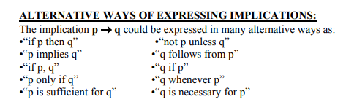

Slide 34
TRANSLATING SYMBOLIC PROPOSITIONS TO ENGLISH:
Let p, q, and r be the propositions:
p = “you have the flu”
q = “you miss the final exam”
r = “you pass the course”
Express the following propositions as an English sentence.
1. p → q
If you have flu, then you will miss the final exam.
2. ~q → r
If you don’t miss the final exam, you will pass the course.
3. ~p ∧ ~q→ r
If you neither have flu nor miss the final exam, then you will pass the course.

